Slide 1



AUTOMATION TESTING ON
BROWSER STACK DEMO
TEAM MEMBERS:
AKHILAVALLI MUPPIRALA
AMULYA JYOTHI THANGELLAMUDI
TUSHAR THITE
MEENA KUMARI SINGAVARAPU
SIVAIAH JAKKAMPUDI
UTSAV SHRIVASTAV
GUIDE: MR. ANAND BHAKTHAVATSALA

Slide 2

INTRODUCTION
BrowserStackDemo is a web-based application designed to demonstrate the functionalities and capabilities of an Electronic Shopping platform. This application serves as a testing ground for various testing tools and strategies, enabling users to interact with a simulated shopping environment. It features a range of products, a shopping cart, and a checkout process, allowing users to experience a complete e-commerce workflow. .
OBJECTIVE
The central aim of this capstone project is to construct a durable and streamlined test automation framework for evaluating the E-commerce store. The framework integrates Selenium, TestNG, Cucumber, Apache POI, a hybrid methodology - Rest Assured and Extent reports for reporting.

Slide 3
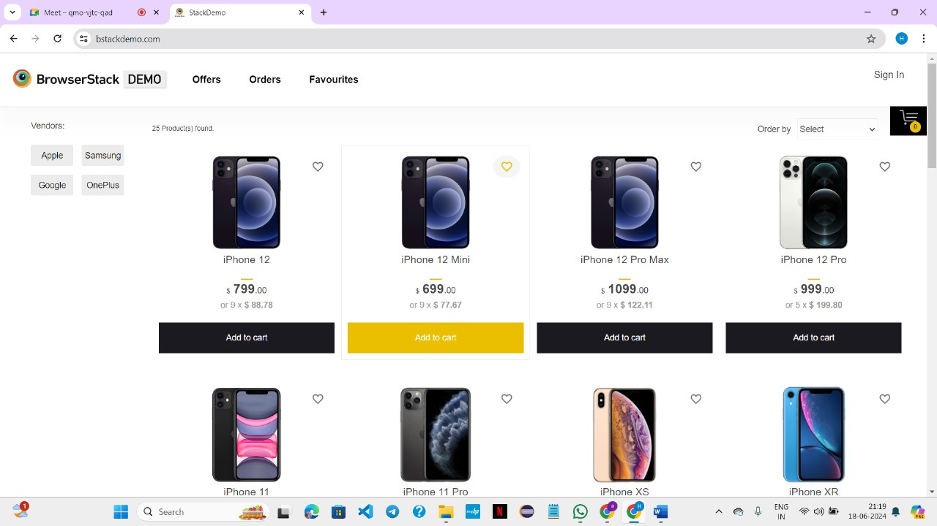
PROBLEM STATEMENT
BrowserStack Demo is an electronic shopping portal, where users log in to browse by vendors or sort products by price. Users can add items to their cart or favorites, edit orders, and remove items in the cart. They can proceed to payment by clicking the Check Out button, entering shipping credentials, and submitting the order later user download the receipt. And user can check his ordersproduct in orders

Slide 4
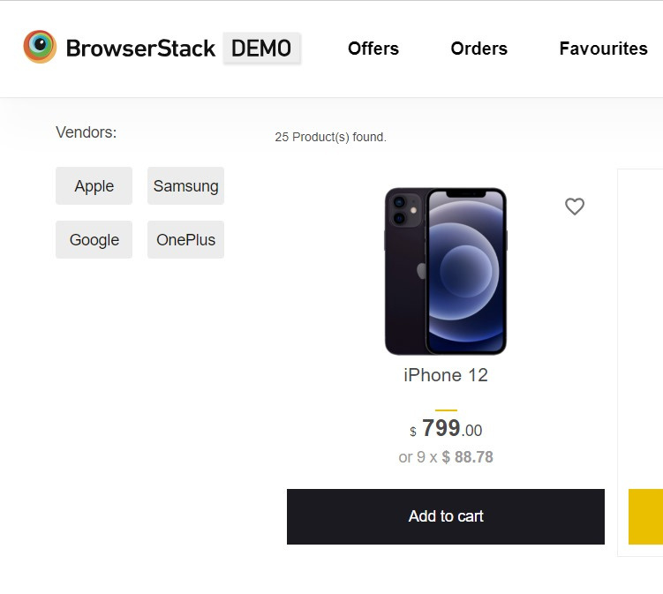
BROWSER STACK DEMO
(Virtual Electronic Gadgets Purchase Site)
Simulated Electronics Gadget Store Experience
Explore and interact with Electronic Items
Virtual Purchases
SIGNIFICANCE
Practical and Controlled Testing Environment
Demonstrate Automation Efficiency and Accuracy
Real - World Challenges and Solutions

Slide 5
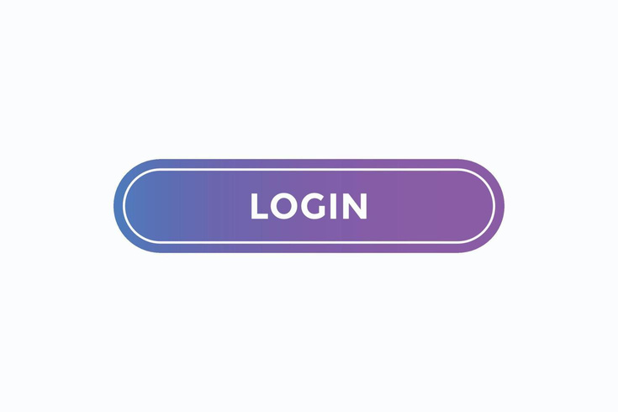


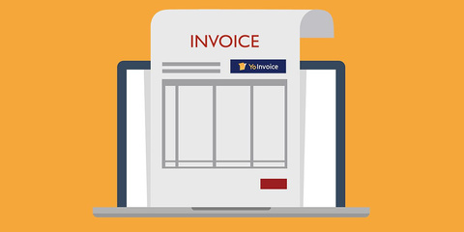
TEST SCENARIOS
PRODUCT DETAILS
SIGN IN
LOGIN
LOGOUT
SELECT MOBILES
SELECT BY ORDER
SELECT BY VENDORS
SELECT FAVORITE BUTTON
ADD TO CART
UPDATE CART
CHECKOUT
SHIPPING DETAILS
DOWNLOAD RECEIPT
MY ORDERS

Slide 6

TEST FLOW
Inc/Dec
QUANTITY
SIGN IN
CHECKOUT
ADD TO
CART
SHIPPING
DETAILS
LOGIN
LOGOUT
VENDOR
VIEW FAVROITE
PAGE
SUBMIT
ORDER
MY ORDERS
ORDER BY
FAVORITE
ICON
DOWNLOAD
RECEIPT
CONTINUE
SHOPPING

Slide 7
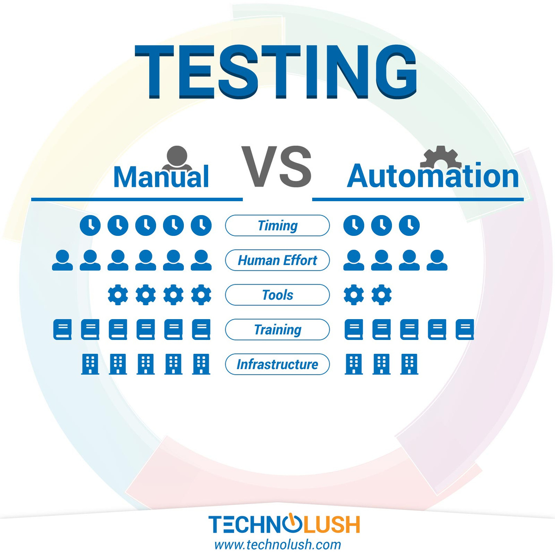
AUTOMATION OVER MANUAL TESTING
Efficiency and Speed
Cost-Effectiveness
Consistency and Repeatability
Comprehensive Testing
Scalability
Performance Testing
Reusability and Maintenance
Detailed Reporting and Analysis
Continuous Integration and Continuous Deployment (CI/CD)

Slide 8



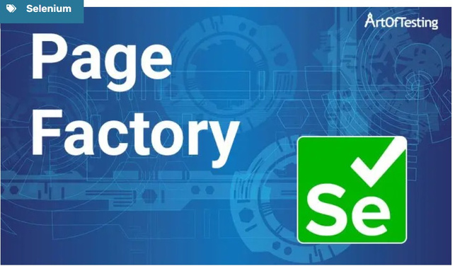
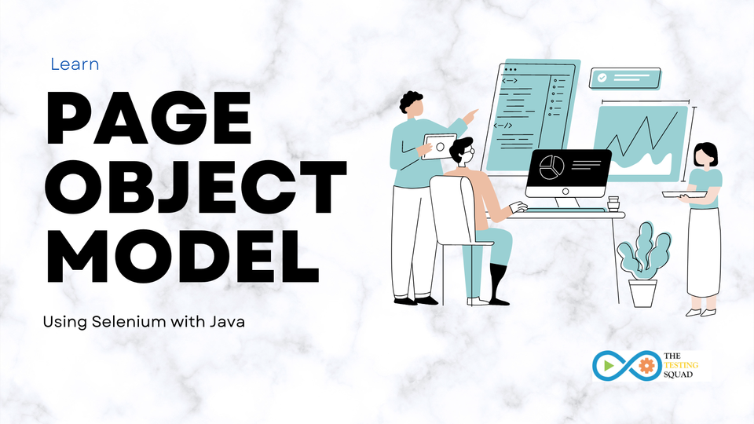

OUR JOURNEY WITH AUTOMATION

Slide 9
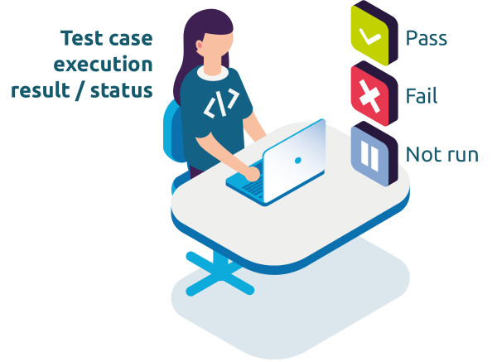
TEST EXECUTION
Test Execution is the process of performing test cases to identify bugs, errors, and other potential issues that a software could have.
Test Execution Phases
Test Execution Cycle
Test Execution State

Slide 10
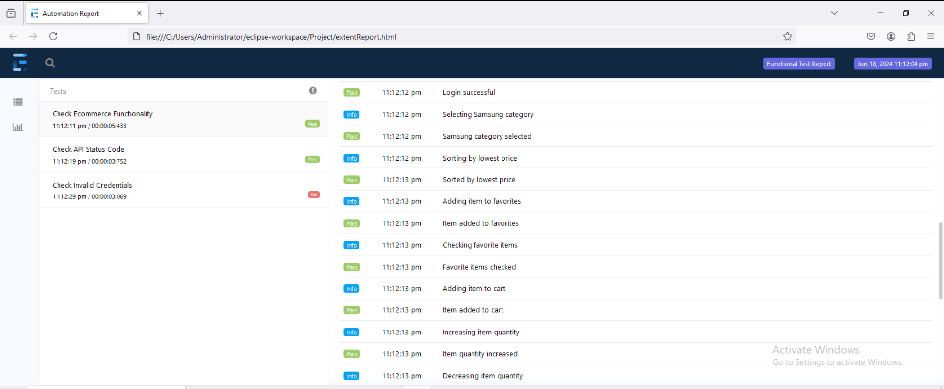
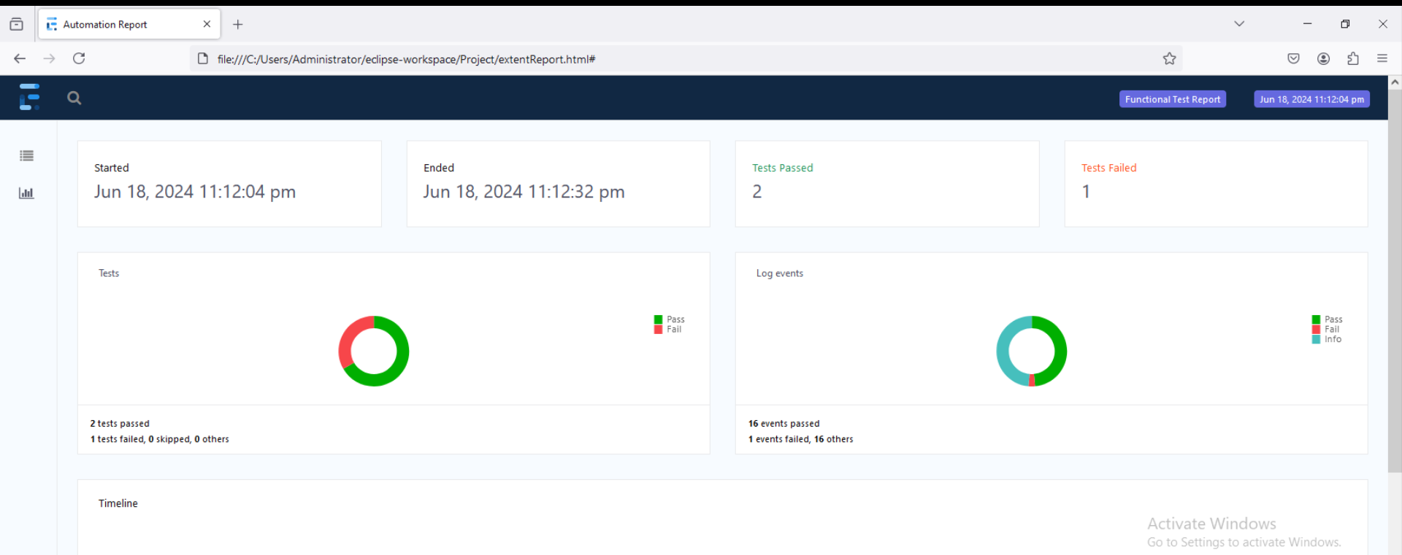
OUR
EXTENT REPORTS
Open-source reporting library useful for test automation.
Easily integrated with major testing frameworks like JUnit, TestNG, etc.
Extent Reports offer several advantages when compared to the built-in reports that are generated through JUnit and TestNG such as pie chart representation, test stepwise report generation, adding screenshots etc

Slide 11

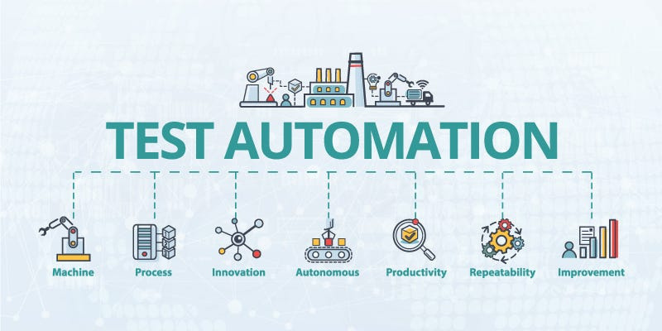
CONCLUSION
Quality Assurance
Efficiency Improvement
Customer Satisfaction
Consistency in Testing
Long-Term Cost Savings

Slide 12
THANK YOU

